Slide 1
Image Segmentation
Image segmentation is the process of dividing an image into distinct regions or segments that share similar attributes such as color, intensity, or texture.
Each segment ideally represents a different object or a part of an object within the image.
It helps in identifying and locating objects and boundaries (lines, curves, etc.) within an image.

Slide 2
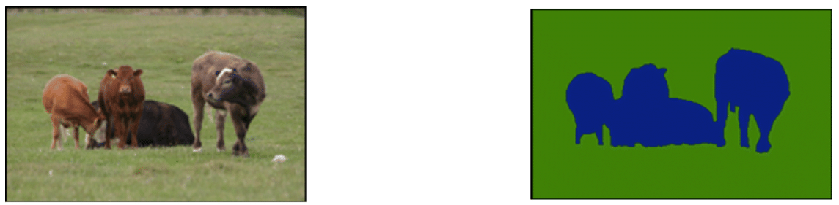
Image Segmentation
Segmentation
Image
Segmented Mask
Source: https://www.researchgate.net/figure/Example-of-clustering-based-image-segmentation-a-Original-image-b-Segmented-image_fig2_349192395

Slide 3
Image Segmentation
Semantic Segmentation
Instance Segmentation
Source: https://www.researchgate.net/figure/Example-of-clustering-based-image-segmentation-a-Original-image-b-Segmented-image_fig2_349192395

Slide 4
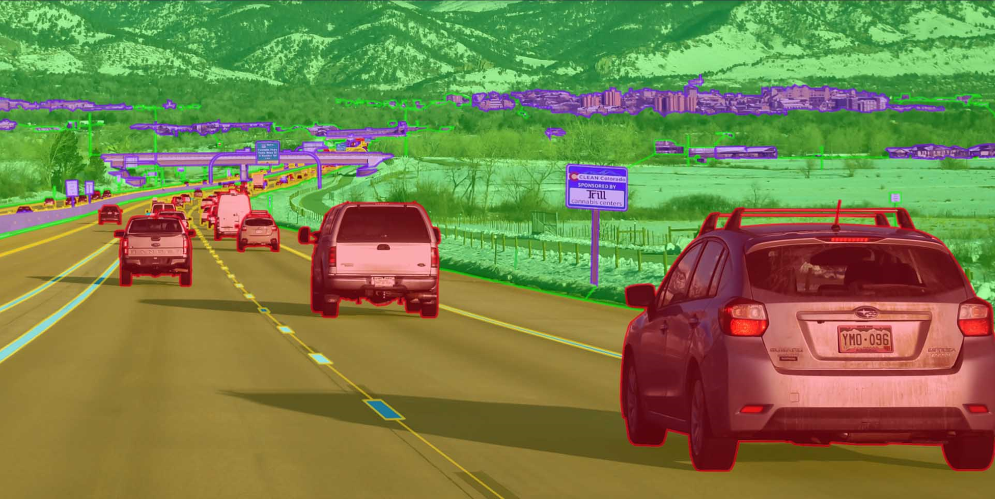
Semantic Segmentation
Semantic segmentation classifies pixels based on their semantic meaning, treating all objects within a category as one entity.
Source: https://keylabs.ai/blog/semantic-segmentation-vs-object-detection-a-comparison/

Slide 5
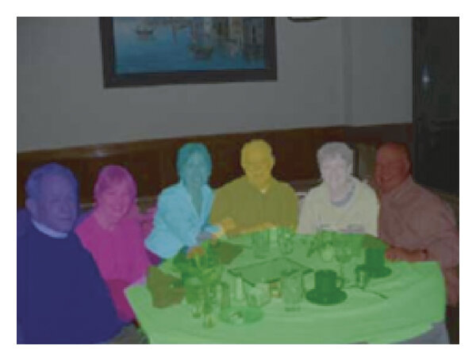
Instance Segmentation
Instance segmentation, distinguishes between different instances of the same class, allowing for more precise object identification and differentiation.
Source: https://www.researchgate.net/figure/Illustration-of-differences-in-segmentation-a-object-detection-b-semantic_fig3_350334710

Slide 6
Types of Image Segmentation
Thresholding-Based Segmentation: Segments an image by converting it into a binary image, distinguishing objects from the background based on intensity values.
Edge-Based Segmentation: Detects object boundaries by identifying significant changes in intensity, effectively highlighting the edges of objects.
Region-Based Segmentation: Groups pixels into regions based on predefined criteria of similarity, such as intensity, color, or texture.
Deep Learning-Based Segmentation: Utilizes neural networks, particularly convolutional neural networks (CNNs), for more advanced and precise segmentation tasks (e.g., U-Net, Mask R-CNN).

Slide 7
Thresholding-Based Segmentation
Input: A gray-scale image I of size M × N
Initialize Parameter: Set a threshold value T. This value can be chosen manually or automatically (e.g., using Otsu’s method).
Iterate Over Each Pixel: For each pixel (i, j) in the image:
Retrieve the intensity value I(i, j)
Apply Threshold: Compare the pixel intensity value I(i, j) with the threshold T:
If I(i, j) ≥ T: classify the pixel as foreground (set to 1 or white in the binary image)
Else-If I(i, j) < T: classify the pixel as background (set to 0 or black in the binary image)
Construct the Binary Image: Create a binary image B of the same size as the input image I.
For each pixel (i,j):
set B(i, j) = 1, if I(i, j) ≥ T (foreground)
set B(i, j) = 0, if I(i, j) ≥ T (background)
Output: The binary image B, where all pixels are either 0 (background) or 1 (foreground).

Slide 8
Thresholding-Based Segmentation
Python code:
def thresholding_segmentation(image, T):
binary_image = np.zeros_like(image)
for i in range(image.shape[0]):
for j in range(image.shape[1]):
if image[i, j] >= T:
binary_image[i, j] = 1
else:
binary_image[i, j] = 0
return binary_image

Slide 9
Points to remember
Choosing the Threshold T:
- The threshold can be set manually if prior knowledge about the image’s intensity distribution is available.
- Automatic methods like Otsu's method can be used to find an optimal threshold that maximizes the separation between the foreground and background.
Handling Noise:
- Thresholding can be sensitive to noise. Pre-processing steps like smoothing (using a Gaussian filter) can help reduce noise before thresholding.
Adaptive Thresholding:
- For images with varying lighting conditions, adaptive thresholding can be used. This method calculates a different threshold for each small region of the image, which allows for better segmentation in non-uniform illumination.

Slide 10
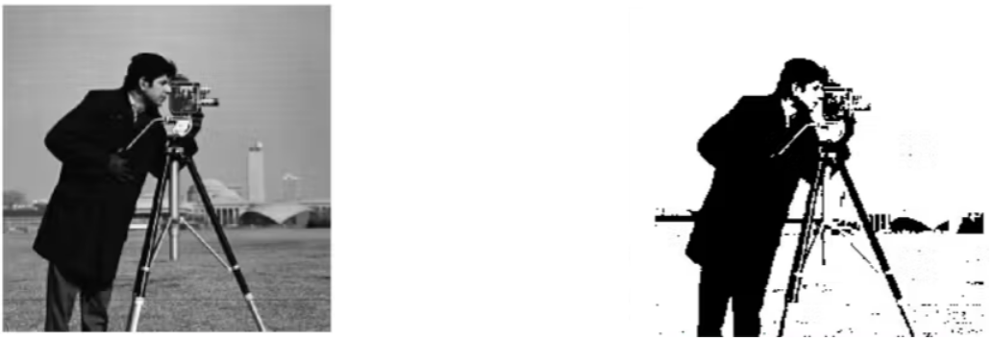
Example
Transformation
Original Image
Threshold and Segmented Image
Source: https://encord.com/blog/image-thresholding-image-processing/

Slide 11
Segmentation using U-Net
U-Net is a type of convolutional neural network (CNN) architecture designed specifically for image segmentation tasks, especially in medical imaging.
Architecture: U-Net has a symmetrical U-shaped structure consisting of two main parts:
Contracting Path (Encoder): This part is similar to a standard CNN. It captures context in the image by using repeated convolutional and max-pooling layers to down-sample the input image and extract features.
Expanding Path (Decoder): This part up-samples the feature maps using transposed convolutions, allowing precise localization and reconstruction of the image. It combines the high-resolution features from the contracting path via skip connections, which help retain spatial information.

Slide 12
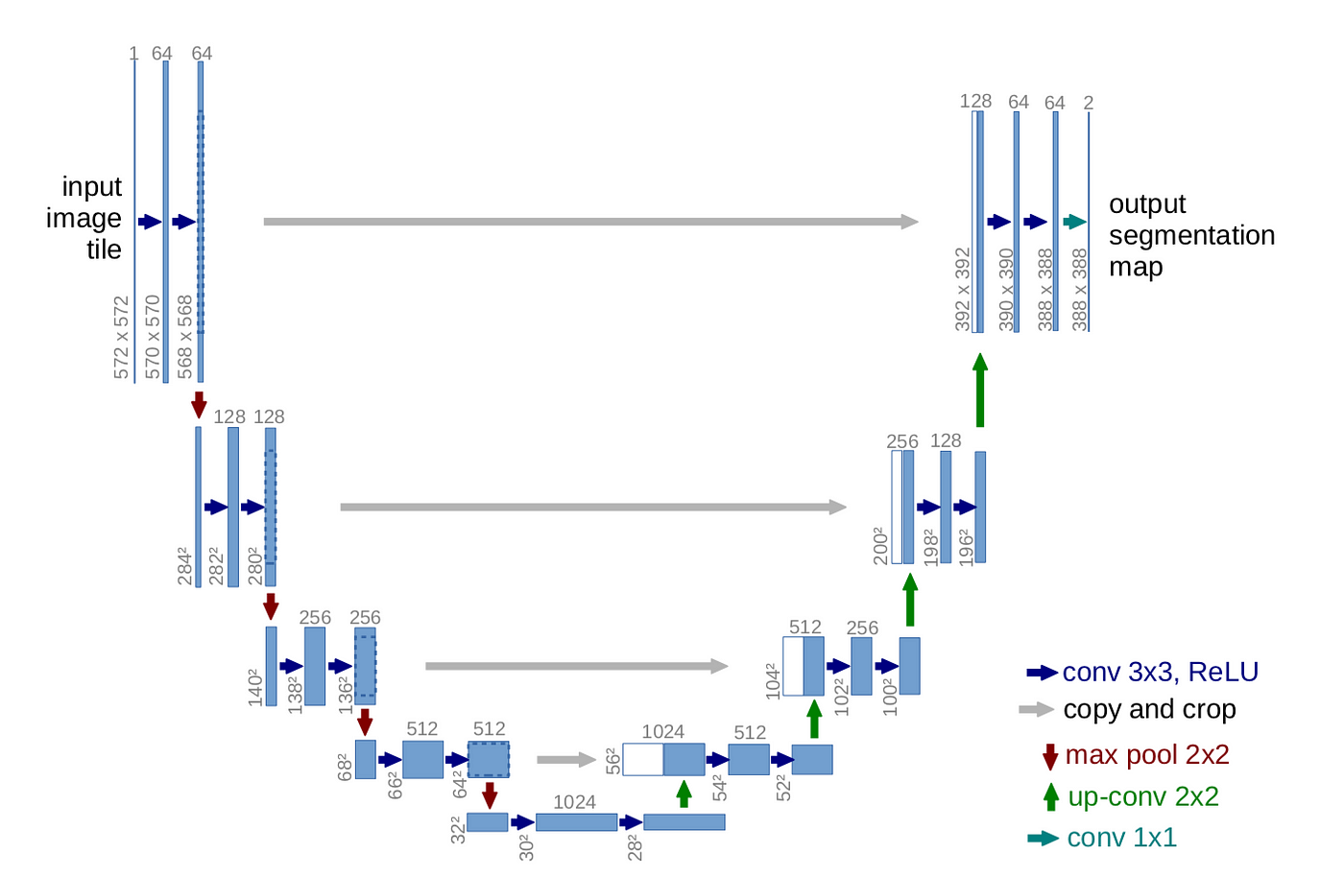
U-Net Architecture
Source: https://towardsdatascience.com/unet-line-by-line-explanation-9b191c76baf5

Slide 13
Application of U-Net
Medical Imaging:
Organ Segmentation: U-Net is extensively used to segment organs such as the liver, kidneys, heart, and lungs from medical scans (CT, MRI). Accurate organ segmentation is crucial for diagnostic purposes and treatment planning.
Tumor Detection: In oncology, U-Net can identify and delineate tumors or abnormal growths in medical images. This helps in assessing tumor size, shape, and growth patterns, which are important for diagnosis and therapy evaluation.
Lesion and Disease Detection: U-Net helps in detecting and segmenting lesions or pathological regions in images. For example, it can be used for segmenting multiple sclerosis lesions in brain MRI scans.
Satellite Imagery:
Land Cover Classification: U-Net can classify different land cover types (e.g., forests, water bodies, urban areas) from satellite images. This is useful for environmental monitoring, urban planning, and disaster management.
Change Detection: It can be used to detect changes over time in satellite images, such as deforestation, urban expansion, or natural disasters.

Slide 14
Application of U-Net
Agriculture:
Crop Monitoring: U-Net can segment different crop types or detect crop health issues from aerial or satellite imagery. This helps farmers monitor crop growth and identify problems such as pest infestations or nutrient deficiencies.
Weed Detection: It helps in differentiating between crops and weeds, enabling targeted weed control and reducing the need for broad-spectrum herbicides.
Biology and Ecology:
Cell Segmentation: U-Net is used to segment and analyze cells in microscopy images, aiding in biological research and understanding cellular structures and functions.
Animal Tracking: It can segment animals or specific features in ecological studies, assisting in tracking and monitoring wildlife populations.

Slide 15
Object Detection
In image processing, object detection refers to the process of identifying and locating specific objects within an image. The goal is to not only determine which objects are present but also to find their exact locations, typically represented by bounding boxes or other geometric shapes.

Slide 16
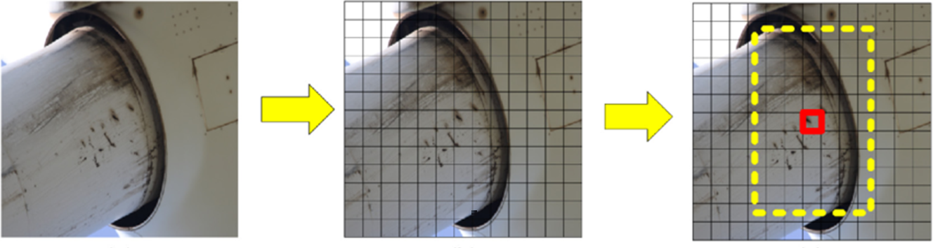
Object Detection
Source: https://www.researchgate.net/figure/Decision-of-the-bounding-box-for-an-input-image-a-Original-image-b-13-13-grids_fig1_335003377

Slide 17
Object Detection
Object Detection methods
Traditional methods
Deep Learning methods
Haar Cascade
HOG with SVM
YOLO
Fast R-CNN

Slide 18
Haar Cascade method
Preprocessing:
Load Image I
Convert Image to Grayscale
Compute Integral Image for efficient feature calculation
Feature Extraction:
Extract Haar Features from the Integral Image for both positive and negative samples
Training:
Collect Dataset: - Positive samples (images with the object)
- Negative samples (images without the object)
Extract Haar Features from the dataset
Train Weak Classifiers: - For each Haar feature, train a weak classifier using the extracted features
Combine Weak Classifiers using AdaBoost to form a Strong Classifier
Build Cascade Classifier: - Arrange the Strong Classifiers into a cascade of stages

Slide 19
Haar Cascade method
Detection:
Initialize Sliding Window with a starting position and scale
For each window position and scale:
- Apply Cascade Classifier to the window
- If the window passes all stages, mark it as a potential object detection
- Move Sliding Window to the next position and scale
Post-Processing:
Apply Non-Maximum Suppression (NMS) to remove overlapping bounding boxes - For each detected bounding box, suppress other boxes that have high overlap (Intersection over Union) with it
Output:
Return Detected Objects with bounding boxes

Slide 20
YOLO (You Only Look Once) algorithm
Input Image:
- An image is resized to a fixed size (e.g., 416x416 pixels) suitable for the YOLO model.
Feature Extraction:
- The resized image is passed through a convolutional neural network (CNN), which extracts features from the image using a series of convolutional layers. This network acts as the backbone, capturing various spatial hierarchies and patterns.
Grid Division:
- The CNN’s output is divided into a grid of cells (e.g., 13x13 or 19x19 cells).
- Each cell is responsible for detecting objects whose center falls within the cell.

Slide 21
YOLO (You Only Look Once) algorithm
Bounding Box and Class Prediction:
- Each grid cell predicts a fixed number of bounding boxes (e.g., 3 boxes per cell).
For each bounding box, it outputs:
Bounding Box Coordinates: Center (x, y), width (w), and height (h) relative to the grid cell.
Objectness Score: Confidence that the bounding box contains an object.
Class Probabilities: Probabilities of each class, indicating which class the object belongs to.
Combine Predictions:
- The outputs from all grid cells are combined to form the final detections.
- This includes bounding boxes, objectness scores, and class probabilities.
Post-Processing:
- Non-Maximum Suppression (NMS): Applied to remove overlapping bounding boxes that have high Intersection over Union (IoU) with each other, keeping only the most confident detections.
Output:
- The final result is a list of detected objects with their bounding boxes and class labels.

Slide 22
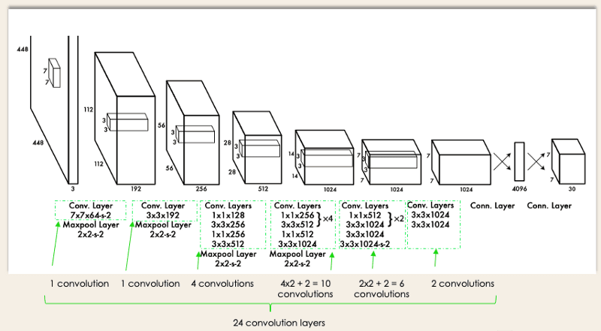
YOLO architecture
Source: https://arxiv.org/pdf/1506.02640

Slide 23
Applications of YOLO
Medical Research
Cell Detection: YOLO can be used to detect and classify different types of cells in microscopic images, aiding in research on cellular biology and disease.
Surgical Instrument Detection: Assisting in real-time detection and tracking of surgical instruments during operations to improve surgical precision.
Physics
Particle Detection: YOLO can assist in identifying and tracking particles in experimental physics, such as detecting tracks of particles in high-energy physics experiments.
Laboratory Experiment Monitoring: Monitoring experimental setups and detecting anomalies or specific components in laboratory settings.
Source: https://arxiv.org/pdf/1506.02640

Slide 24
Applications of YOLO
Agriculture
Crop Monitoring: YOLO can help in detecting crop diseases, pests, or growth stages from aerial or ground-level images, improving precision agriculture practices.
Weed Detection: Identifying and classifying weeds in agricultural fields to optimize herbicide application and reduce crop competition.
Astronomy
Celestial Object Detection: YOLO can be applied to detect and classify celestial objects like asteroids, comets, and stars in astronomical images or video data.
Space Debris Monitoring: Detecting and tracking space debris in satellite imagery to prevent collisions.

